Slide 1

Department of Artificial Intelligence and Data Science
CSA4001 –Management Information Systems for Data Optimization
ONLINE LEARNING MANAGEMENT SYSTEM
(LMS)
SUBMITTED BY
SWATHI J U (192124129)
Date of Submission:20/3/2025

Slide 2
Abstract
This project presents a Cloud-based Online Learning Management System (LMS) that efficiently manages 100+ courses, 500+ faculty, and 1,000+ student enrollments.
It addresses the challenge of handling large-scale academic data with secure, scalable, and centralized management.
The system uses DBMS and SQL to enable easy course registrations, material access, testing, and certification.
Faculty dashboards and real-time student progress tracking enhance monitoring and reporting.
The solution ensures high availability, data security, and seamless performance through cloud deployment.

Slide 3
Table of Contents
Introduction
Problem Identification and Analysis Solution
Design and Implementation Results and Recommendations
Coding
Output Screenshots
Reflection on Learning and Personal Development
Conclusion
References
Appendices

Slide 4
Introduction
The LMS provides a single platform where students and instructors can access and manage course materials, assignments, and resources in one place, ensuring smooth communication and workflow.
Cloud storage offers scalable and cost-effective solutions to store educational content, making it accessible anytime, anywhere, without the need for extensive physical infrastructure.
Advanced security features like data encryption, user authentication, and automated backups protect sensitive student data and course materials, ensuring privacy and data integrity.
The system enables instant updates and collaboration, allowing students and instructors to access materials, submit assignments, and provide feedback in real-time, enhancing the learning experience..

Slide 5
Problem Identification and Analysis
Scalability Challenge: Support 500+ courses and 1000+ registrations per course efficiently.
Data Security & Privacy: Ensure end-to-end encryption for user data and course materials.
Cloud Storage Integration: Store and manage course content securely using AWS S3 or equivalent.
Advanced Learning Features: Implement workshops, presentations, tests, and certifications for enhanced engagement.
Seamless User Experience: Provide secure authentication, role-based access, and smooth course navigation.

Slide 6
Solution Design and Implementation
Development and Design Process:
Designed a scalable LMS architecture with clear database schema, cloud deployment planning, and responsive UI for faculty and student portals.
Tools and Technologies Used:
Cloud computing platform (AWS/GCP), MySQL for database, HTML, CSS, JavaScript for frontend, and PHP/Python for backend integration.
Solution Overview:
A centralized system that manages 100+ courses, 500+ faculty, and 1,000+ enrollments, with real-time progress tracking, test management, and certificate automation.
Application of Engineering Standards:
Followed secure coding practices, data integrity constraints in SQL, scalability principles, and modular system design for efficient maintenance and upgrades.

Slide 7
Results and Recommendations
Evaluation of the Results:
The LMS successfully handles 100+ courses, 500+ faculty, and 1,000+ student enrollments, with efficient course management, secure data handling, and real-time progress monitoring.
Challenges Encountered:
Faced scalability issues during peak load testing, database query optimization challenges, and integration complexities across modules.
Possible Improvements:
Implement AI-based recommendation systems for personalized course suggestions, advanced analytics dashboards, and mobile app integration.
Recommendations for Future Work:
Migrate to serverless cloud architecture for better scalability, integrate multi-language support, and enable third-party API integration for wider.

Slide 8
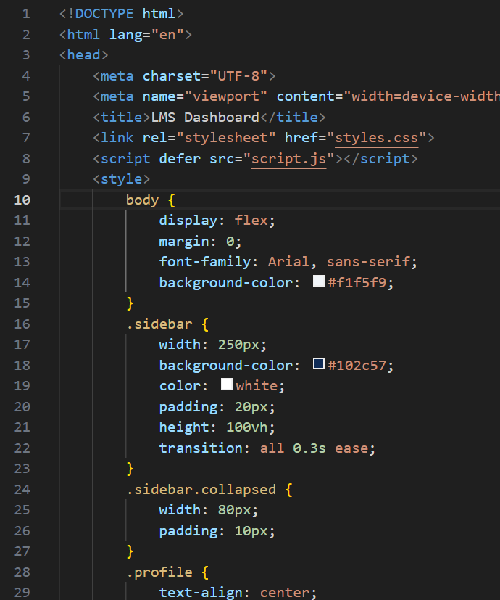
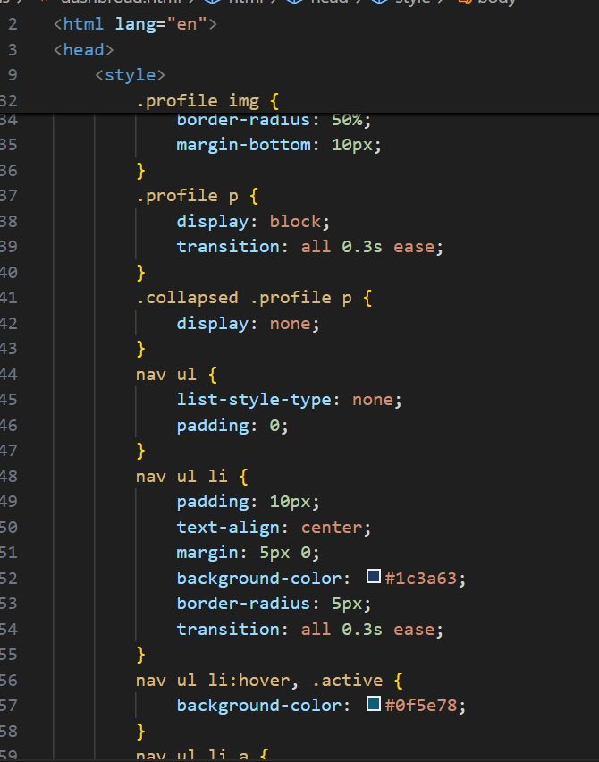
Coding

Slide 9
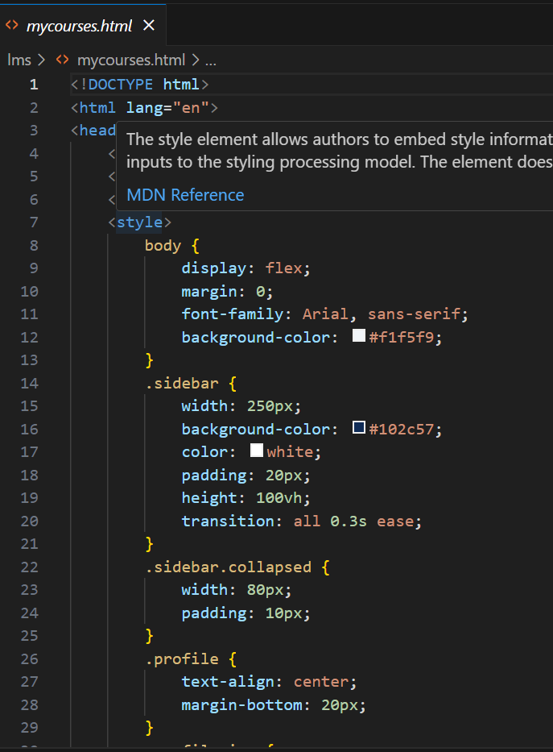
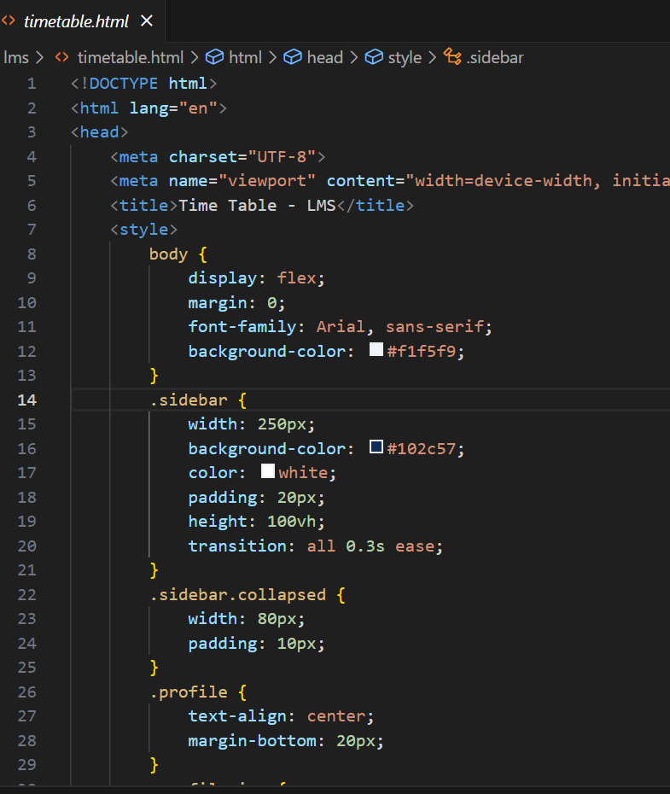
Coding

Slide 10
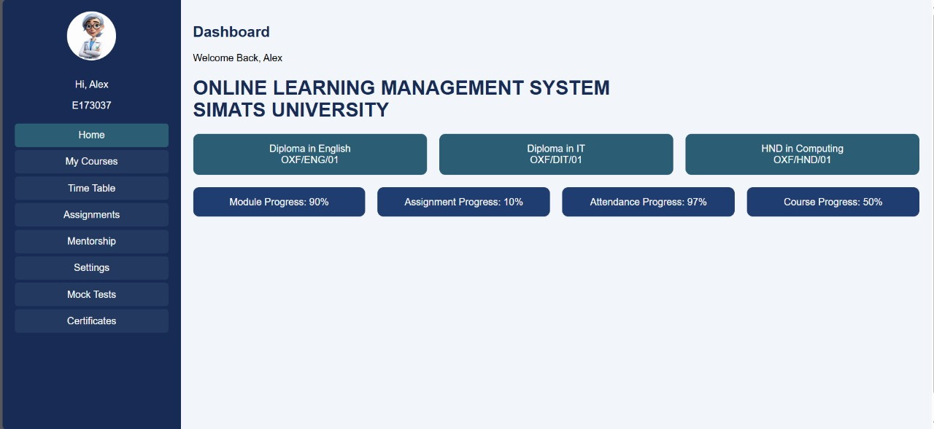
Output Screenshots

Slide 11
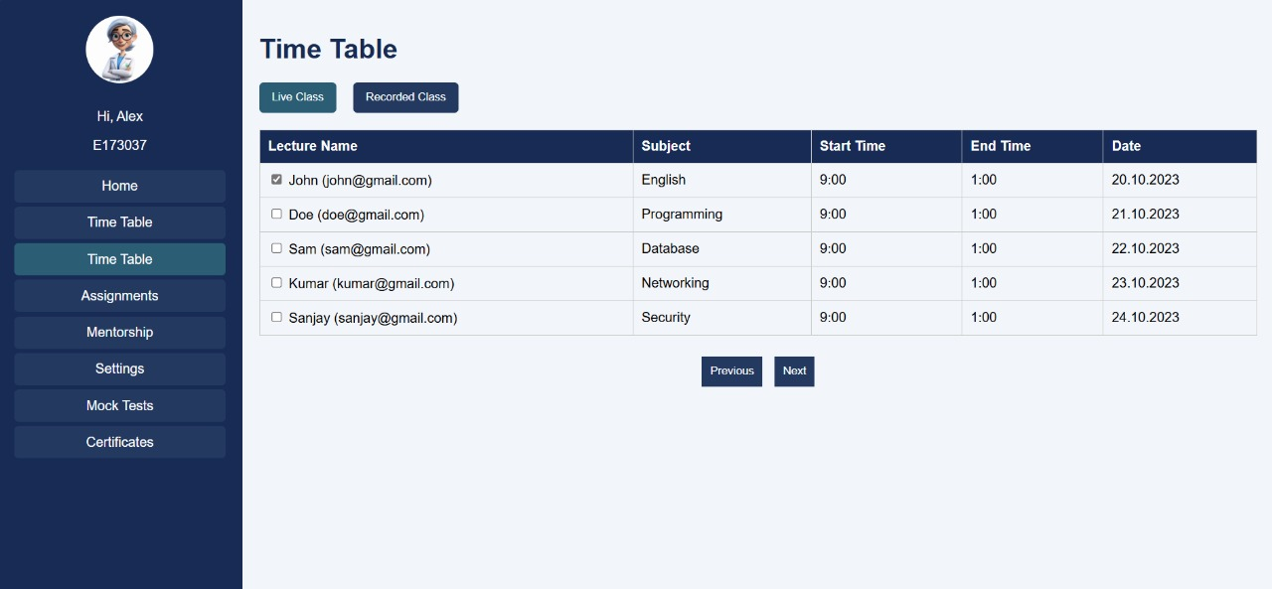
Output Screenshots

Slide 12
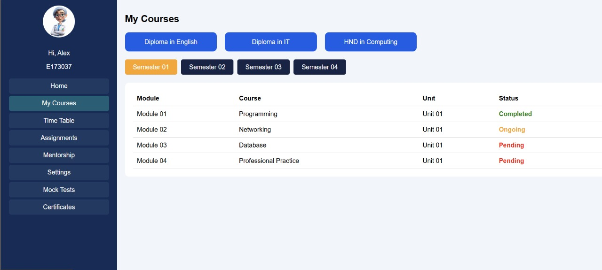
Output Screenshots

Slide 13
Reflection on Learning and Personal Development
Key Learning Outcomes:
Gained in-depth understanding of cloud-based system design, SQL database management, and large-scale application development.
Technical and Problem-Solving Skills Gained:
Developed skills in database optimization, cloud deployment, backend integration, and handling complex queries and scalability issues.
Collaboration and Communication Insights:
Improved teamwork through clear task delegation, effective communication, and collaborative design discussions.
Application of Engineering Standards:
Followed best practices in secure coding, modular design, data validation, and system scalability standards.
Industry Insights:
Learned how cloud-based LMS solutions are becoming essential in modern education, highlighting the importance of security, flexibility, and real-time analytics in industry-grade platforms.

Slide 14
Conclusion
Summary of Findings:
The LMS effectively manages 100+ courses, 500+ faculty, and 1,000+ enrollments, providing a secure, scalable, and user-friendly platform for online education.
Importance of the Project:
Demonstrates how cloud computing and database technologies can revolutionize educational management, enabling real-time learning, monitoring, and resource sharing.
Final Thoughts:
The project highlights the growing need for robust, scalable learning platforms, and sets a foundation for future enhancements like AI integration, advanced analytics, and mobile support for industry-level LMS solutions.

Slide 15
References
Bao, W. (2020). COVID-19 and online teaching in higher education: A case study of Peking University. Human Behavior and Emerging Technologies, 2(2), 113-115.
Hodges, C., Moore, S., Lockee, B., Trust, T., & Bond, A. (2020). The difference between emergency remote teaching and online learning. Educause Review, 27, 1-12.
Kumar, P., Kumar, A., Palvia, S., & Verma, S. (2019). Online business education research: Systematic analysis and a conceptual model. The International Journal of Management Education, 17(1), 26-35.
Zhao, Y., & Watterston, J. (2021). The changes we need: Education post COVID-19. Journal of Educational Change, 22(1), 3-12.

